Slide 1
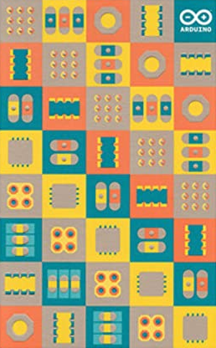
YOU’RE
ON MUTE!
A Device to Control M$ Teams
Paul Harvey

Slide 2
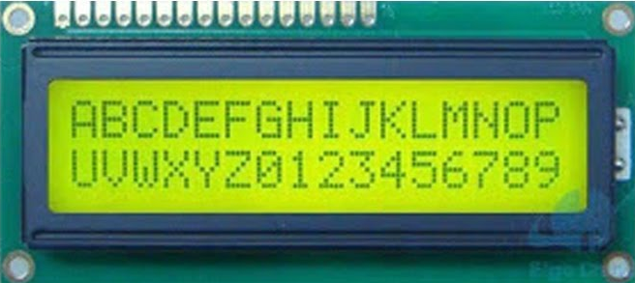



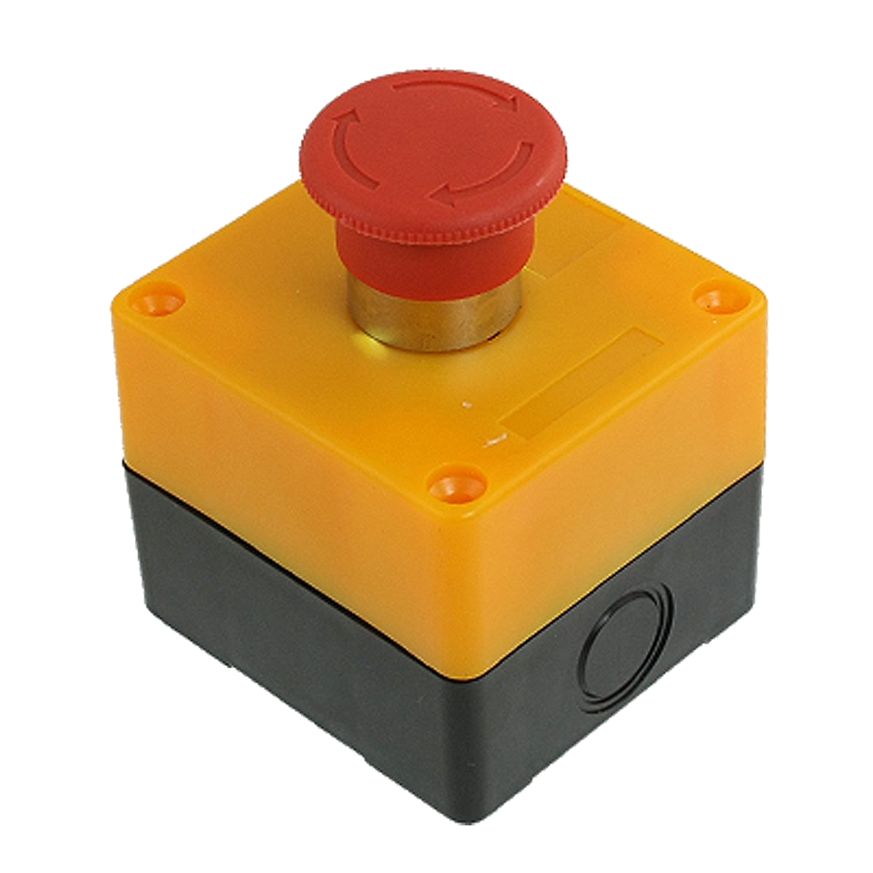
Components of the Solution
101010010101
Cycle
Windows
Toggle
Mute
Toggle
Camera
External
Wireless
PC software to
hardware
protocol
control teams

Slide 3
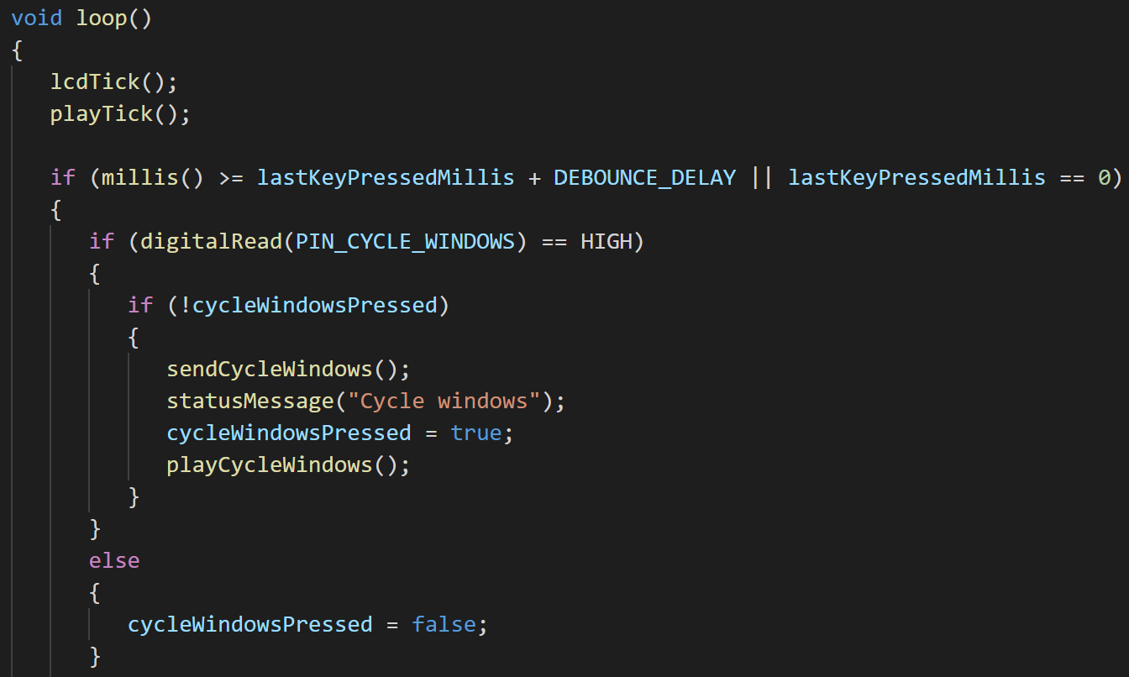
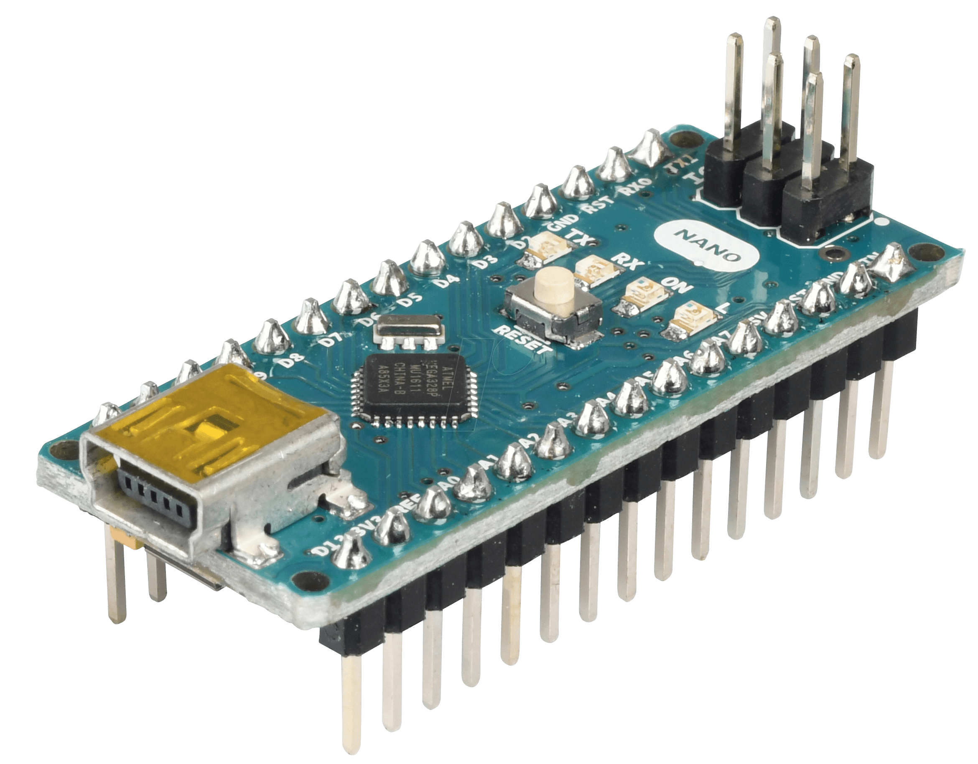
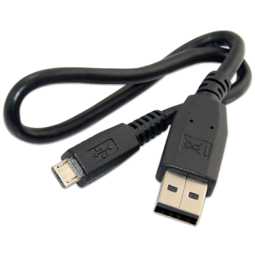
Hardware - Microcontroller
C++
Arduino Nano
Compile
Monitor switch pins
Marshall/send protocol
Update display
Play tones
De-marshall protocol and dispatch
ATmega328 Microcontroller
32K Flash
2K DRAM
14 digital I/O pins
8 Analogue I/O pins
40 mA per pin
Upload

Slide 4
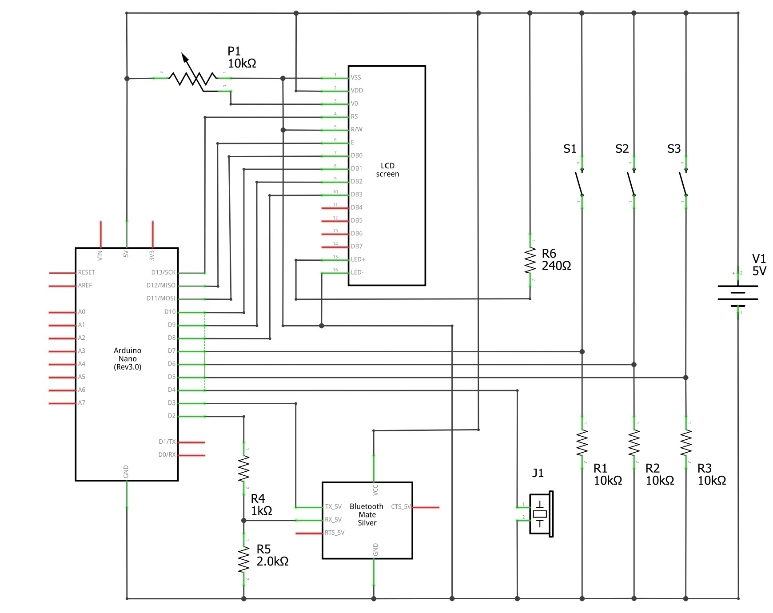
Hardware - Schematic
P1 – LCD contrast
LCD
S1 – Cycle
S2 – Mute
S3 - Camera
R6 - Current limiting resistor for LED backlight
Arduino Nano
R1, R2, R3 - Pulldown resistors
Bluetooth/ HC-05
R4, R5 - Voltage divider
J1 – Piezo buzzer

Slide 5
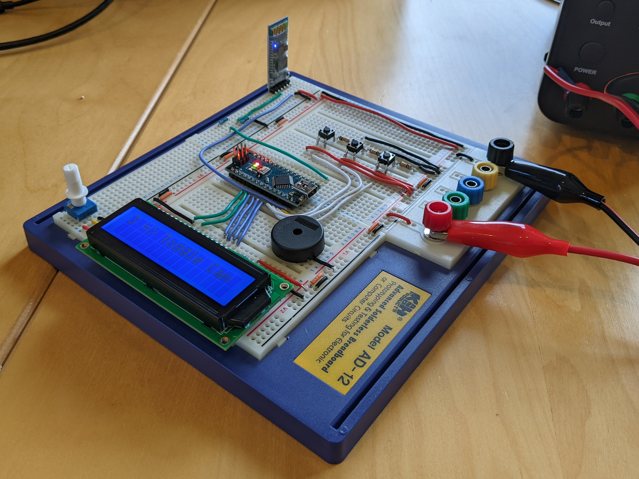
Hardware - Reality
Bluetooth/ HC-05
R4, R5 - Voltage divider
S1 – Cycle
S2 – Mute
S3 - Camera
R1, R2, R3 - Pulldown resistors
Arduino Nano
P1 – LCD contrast
R6 - Current limiting resistor for LED backlight
LCD
J1 – Piezo buzzer

Slide 6
Protocol
Packet Structure
Offset | 0 | 1 | 2…n
Function | Length | OpCode | Payload
Operations
OpCode | Name | In/Out | Payload | Description
0x01 | Cycle Windows | Out | - | Cycle Teams windows to the front.
0x02 | Toggle Mute | Out | - | Toggle microphone mute
0x03 | Toggle Video | Out | - | Toggle video camera
0x04 | Error | In | - | An error condition has occurred
0xFF | Debug | Out | String | Send a debug message

Slide 7
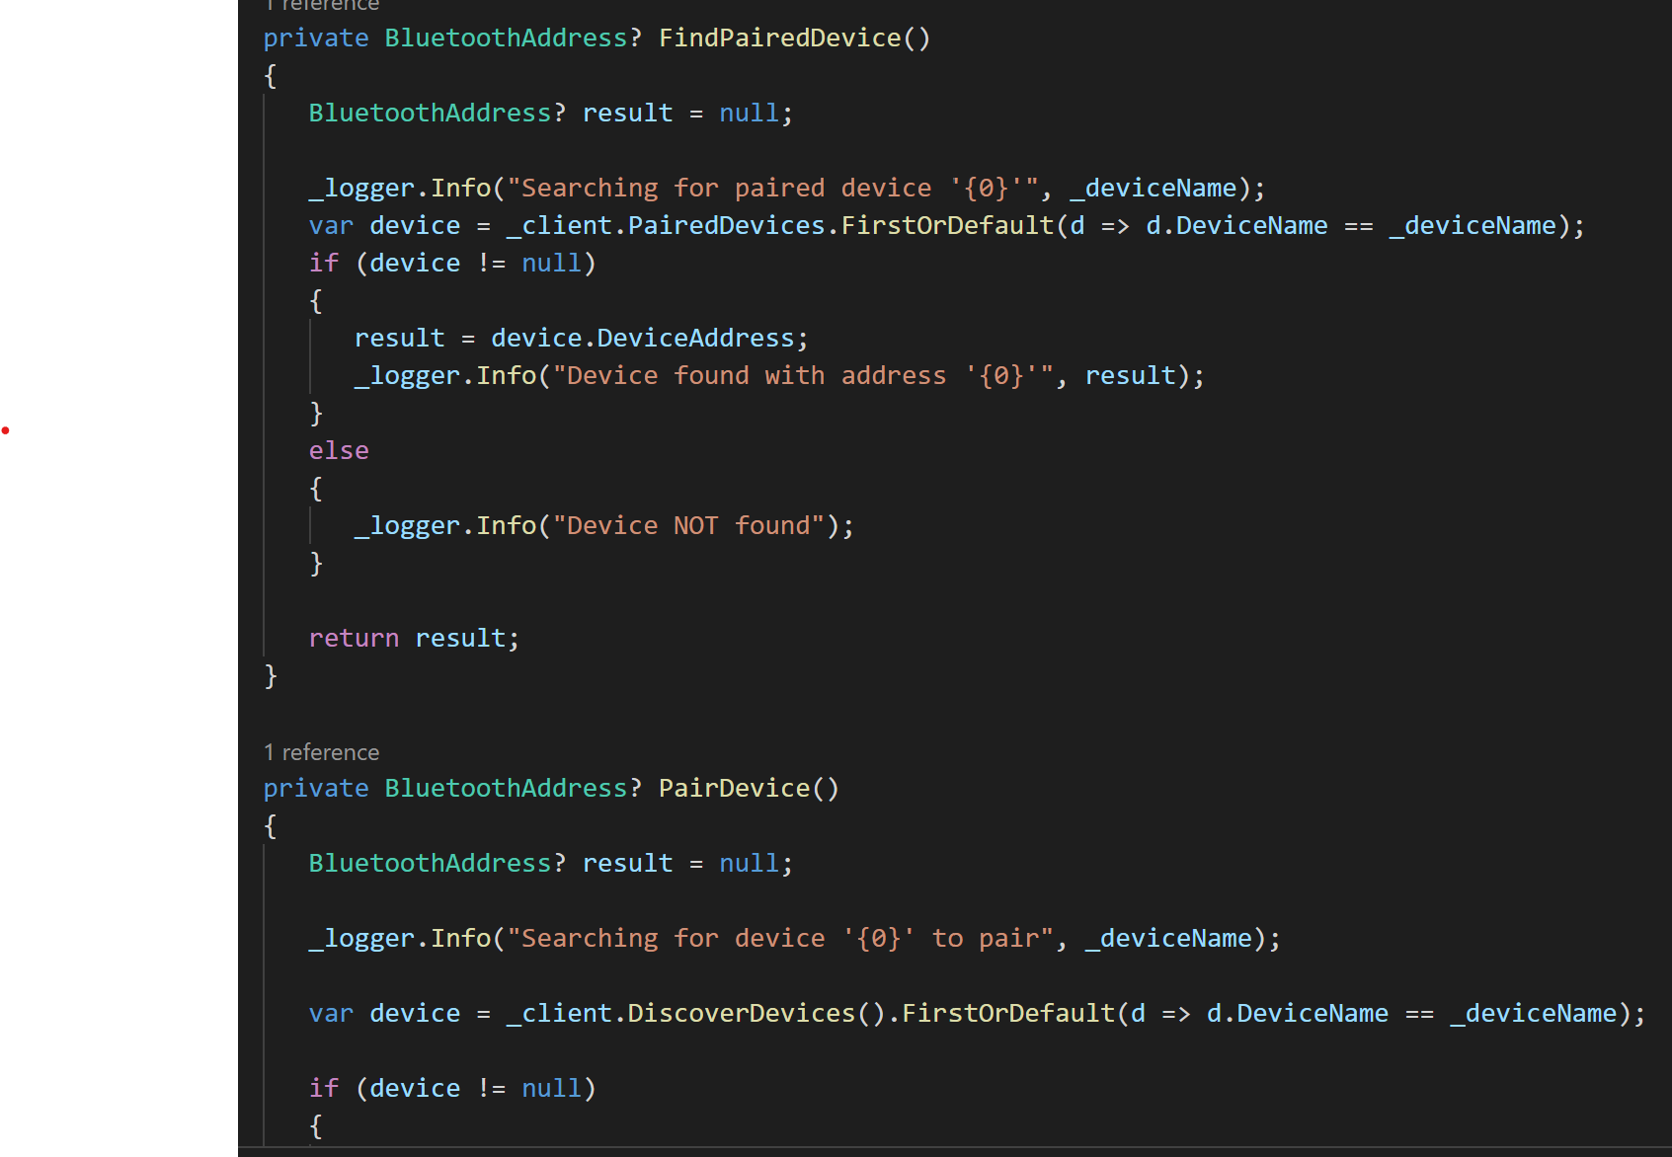
PC Software
C#
Pair and connect Ardiuno via BT
De-marshall protocol and dispatch
Interact with Teams to cycle windows/toggle mute/toggle camera

Slide 8
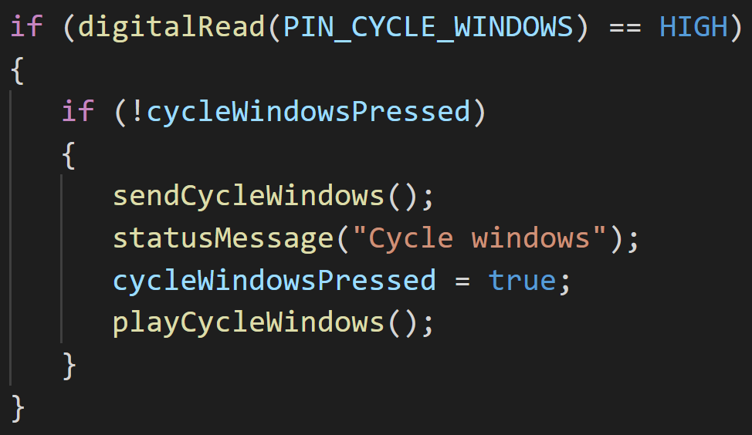

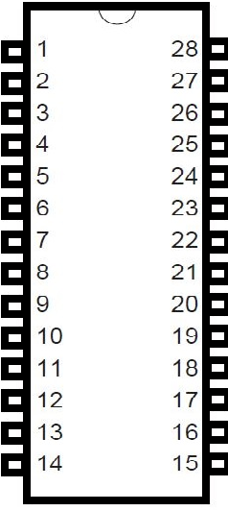
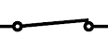
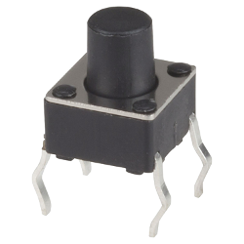
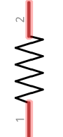
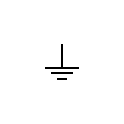
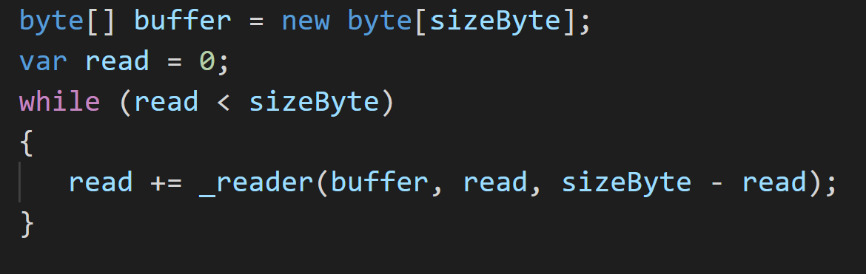
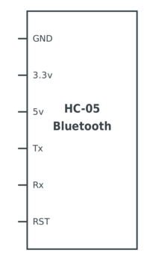
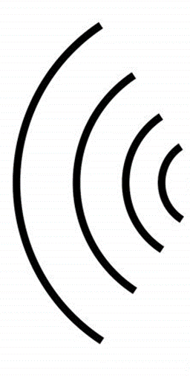
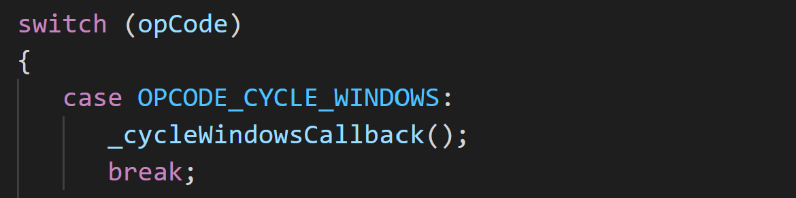
Tracing an Example
2
+5V
3
1
+5V
ATMega328
0V
4
0x01 0x01
4
HC-05

Slide 9
Demo

Slide 10
Bill of Materials
Wired/USB
Wireless/Bluetooth
Component | # | Total Cost
Arduino Nano | 1 | £5.66
LCD Display | 1 | £3.99
Resistors | 4 | £0.04
Potentiometer | 1 | £0.07
Switch | 3 | £0.09
Piezo Buzzer | 1 | £0.50
Component | # | Total Cost
HC-05 | 1 | £4.80
Resistors | 2 | £0.02
Battery Power
Component | # | Total Cost
Buck Converter | 1 | £2.33
Approx. £10.00

Slide 11
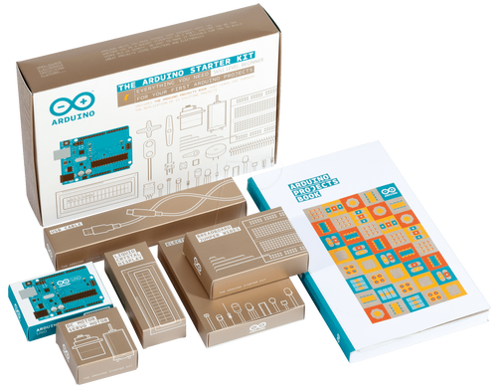
Try Yourself?
The
Arduino
Starter
Kit

